Slide 1


Community Research On Climate and Urban Science
Community Research on Climate and Urban Science (CROCUS) Urban Integrated Field Laboratory
Instrumentation Intro
CROCUS Measurement Strategy Team
Joe O’Brien¹, Scott Collis¹, Paytsar Muradyan¹, Max Grover¹, Matt Tuftedal¹, Dimitrios Fytanidis¹, Robert Jackson¹, Greg Anderson³, Pete Beckman¹², Bhupendra Raut², Rajesh Sankaran², Sean Shahkarami²
¹Argonne National Laboratory
²Northwestern University
³Northeastern Illinois University

Slide 2
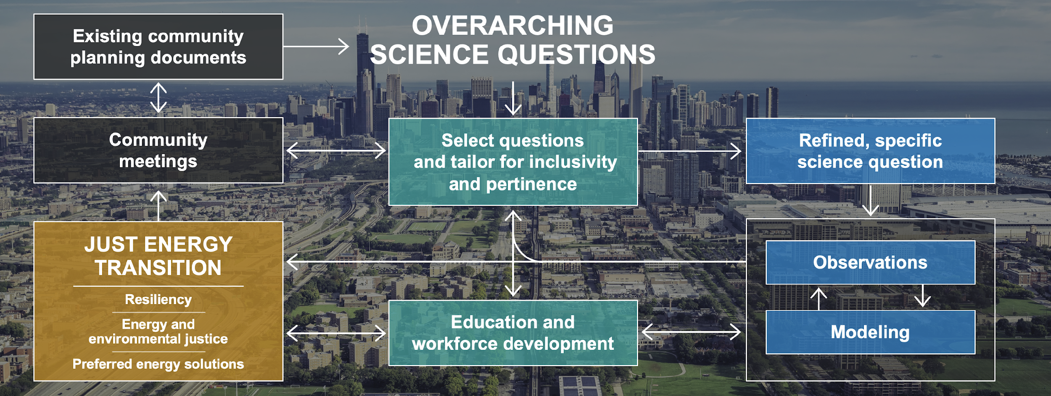
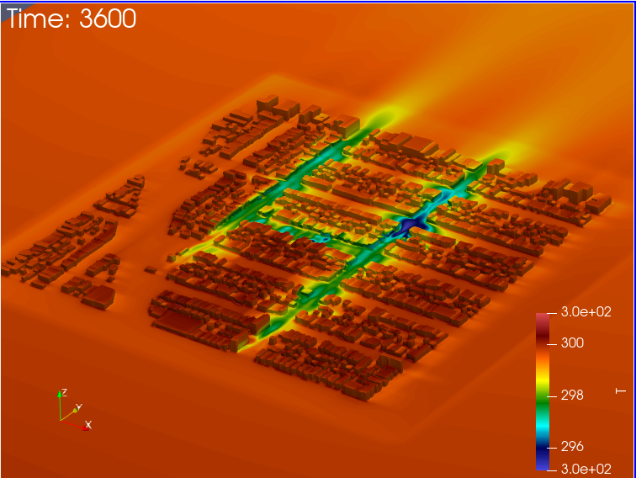
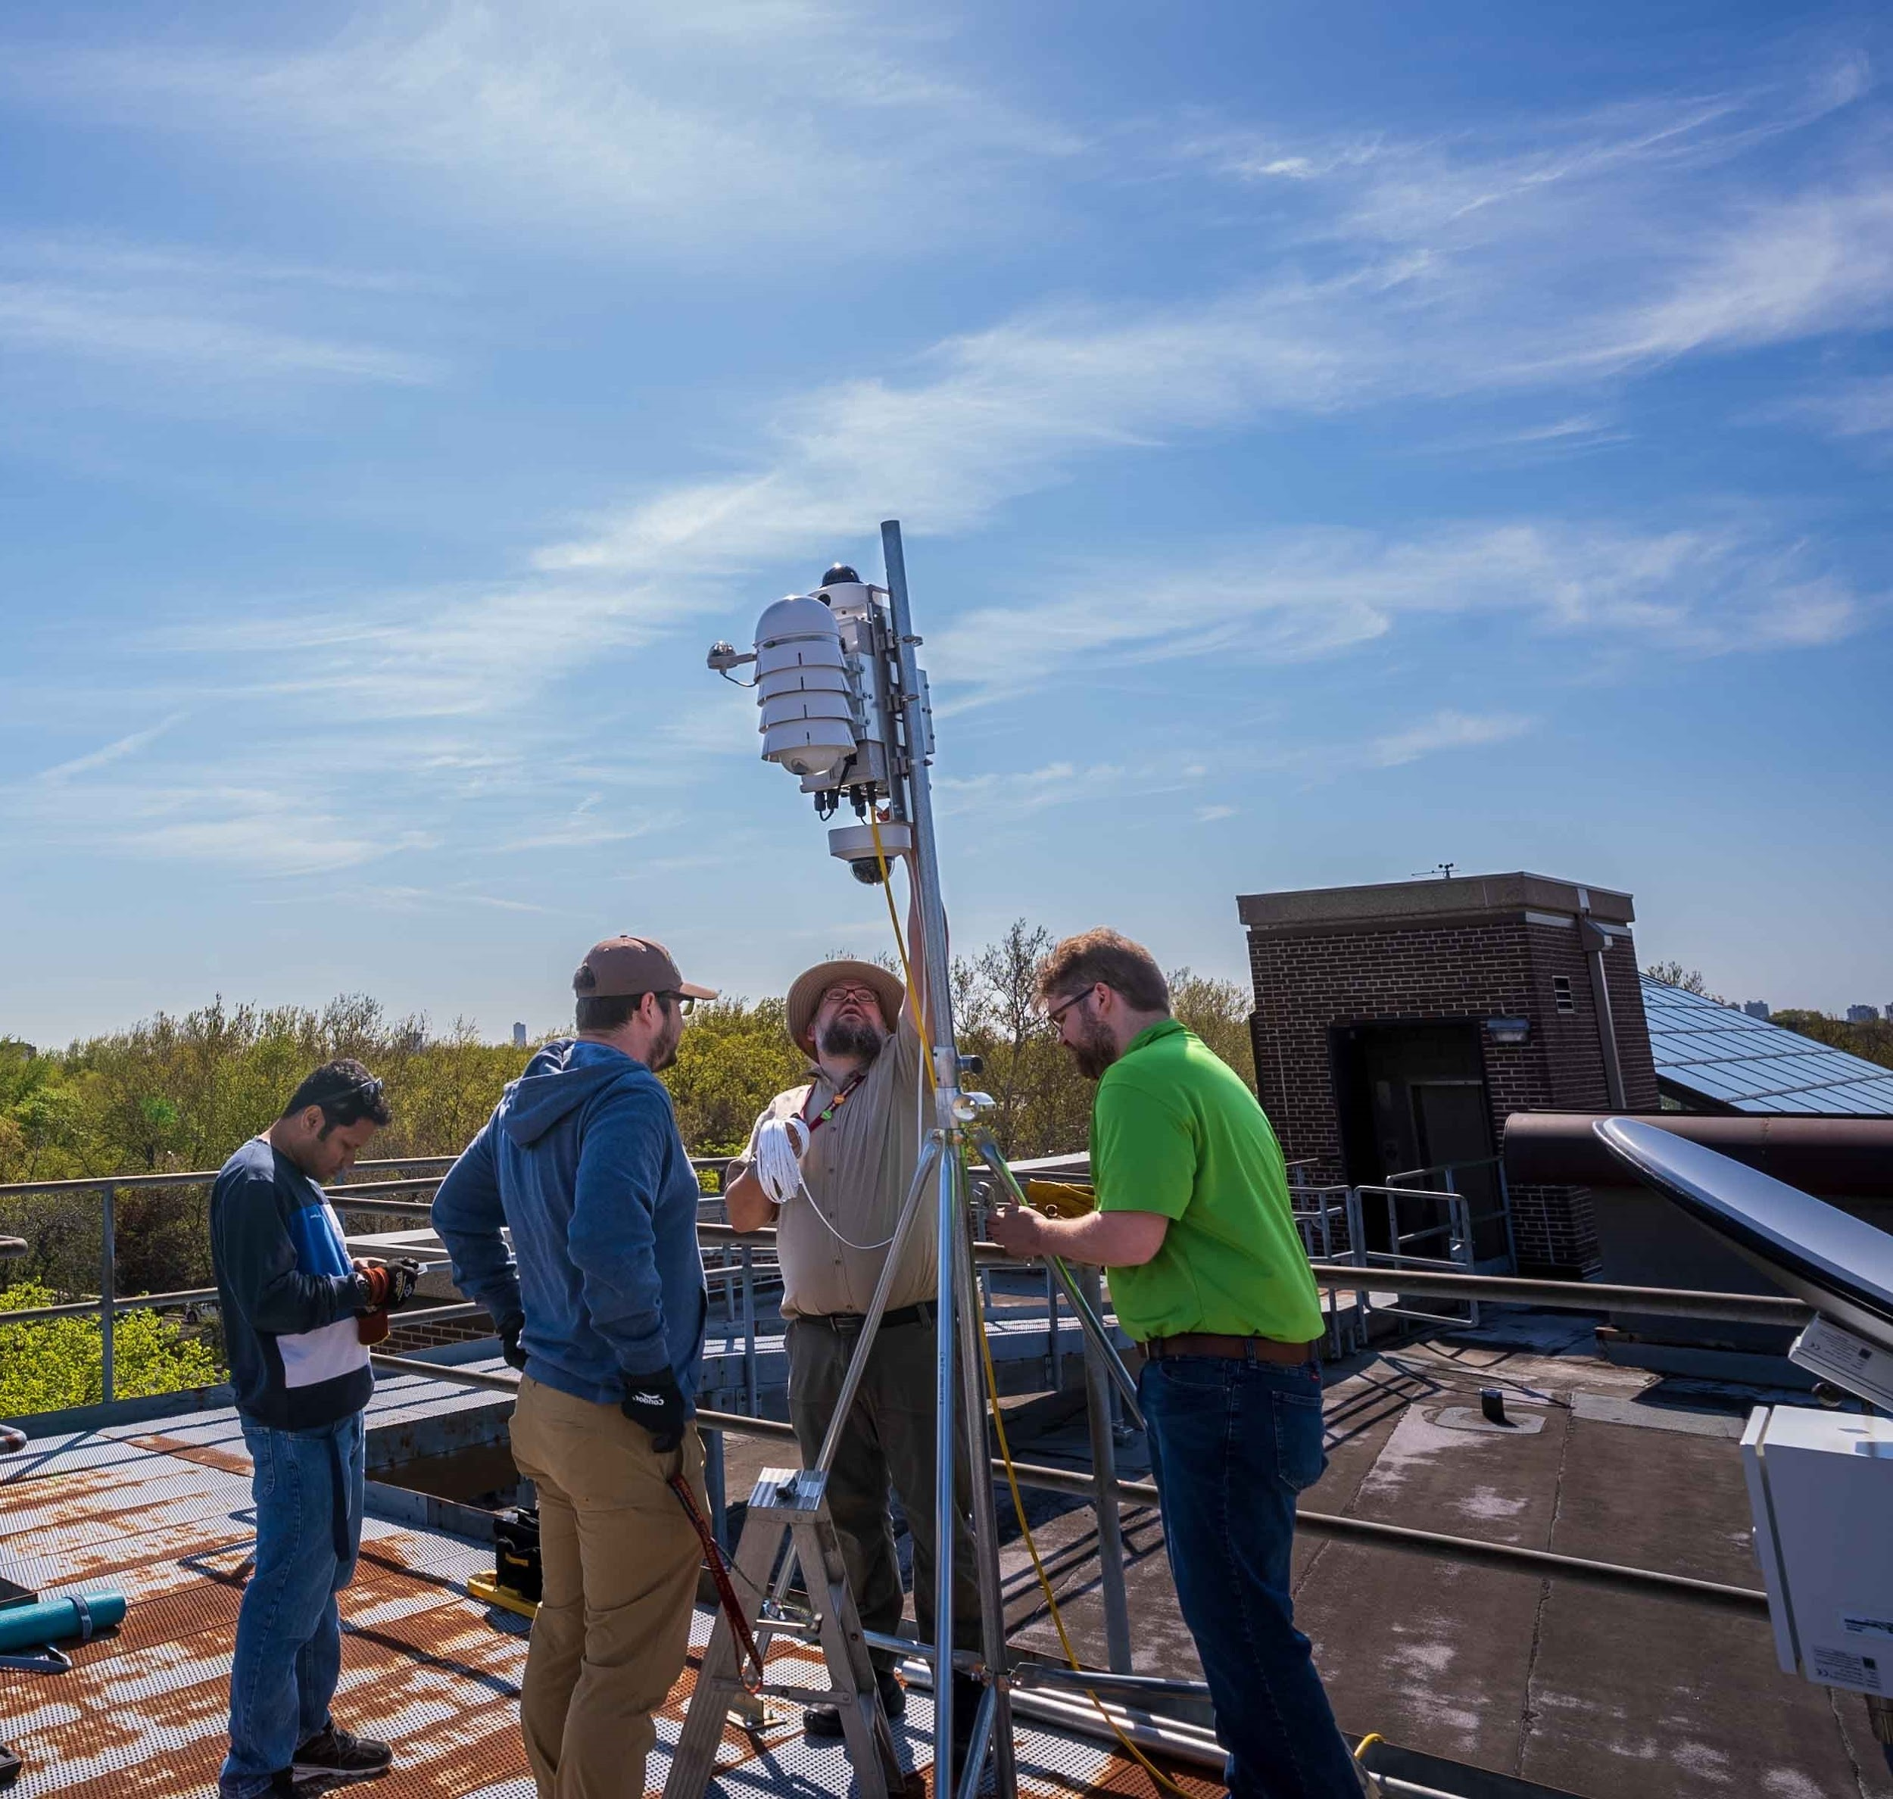
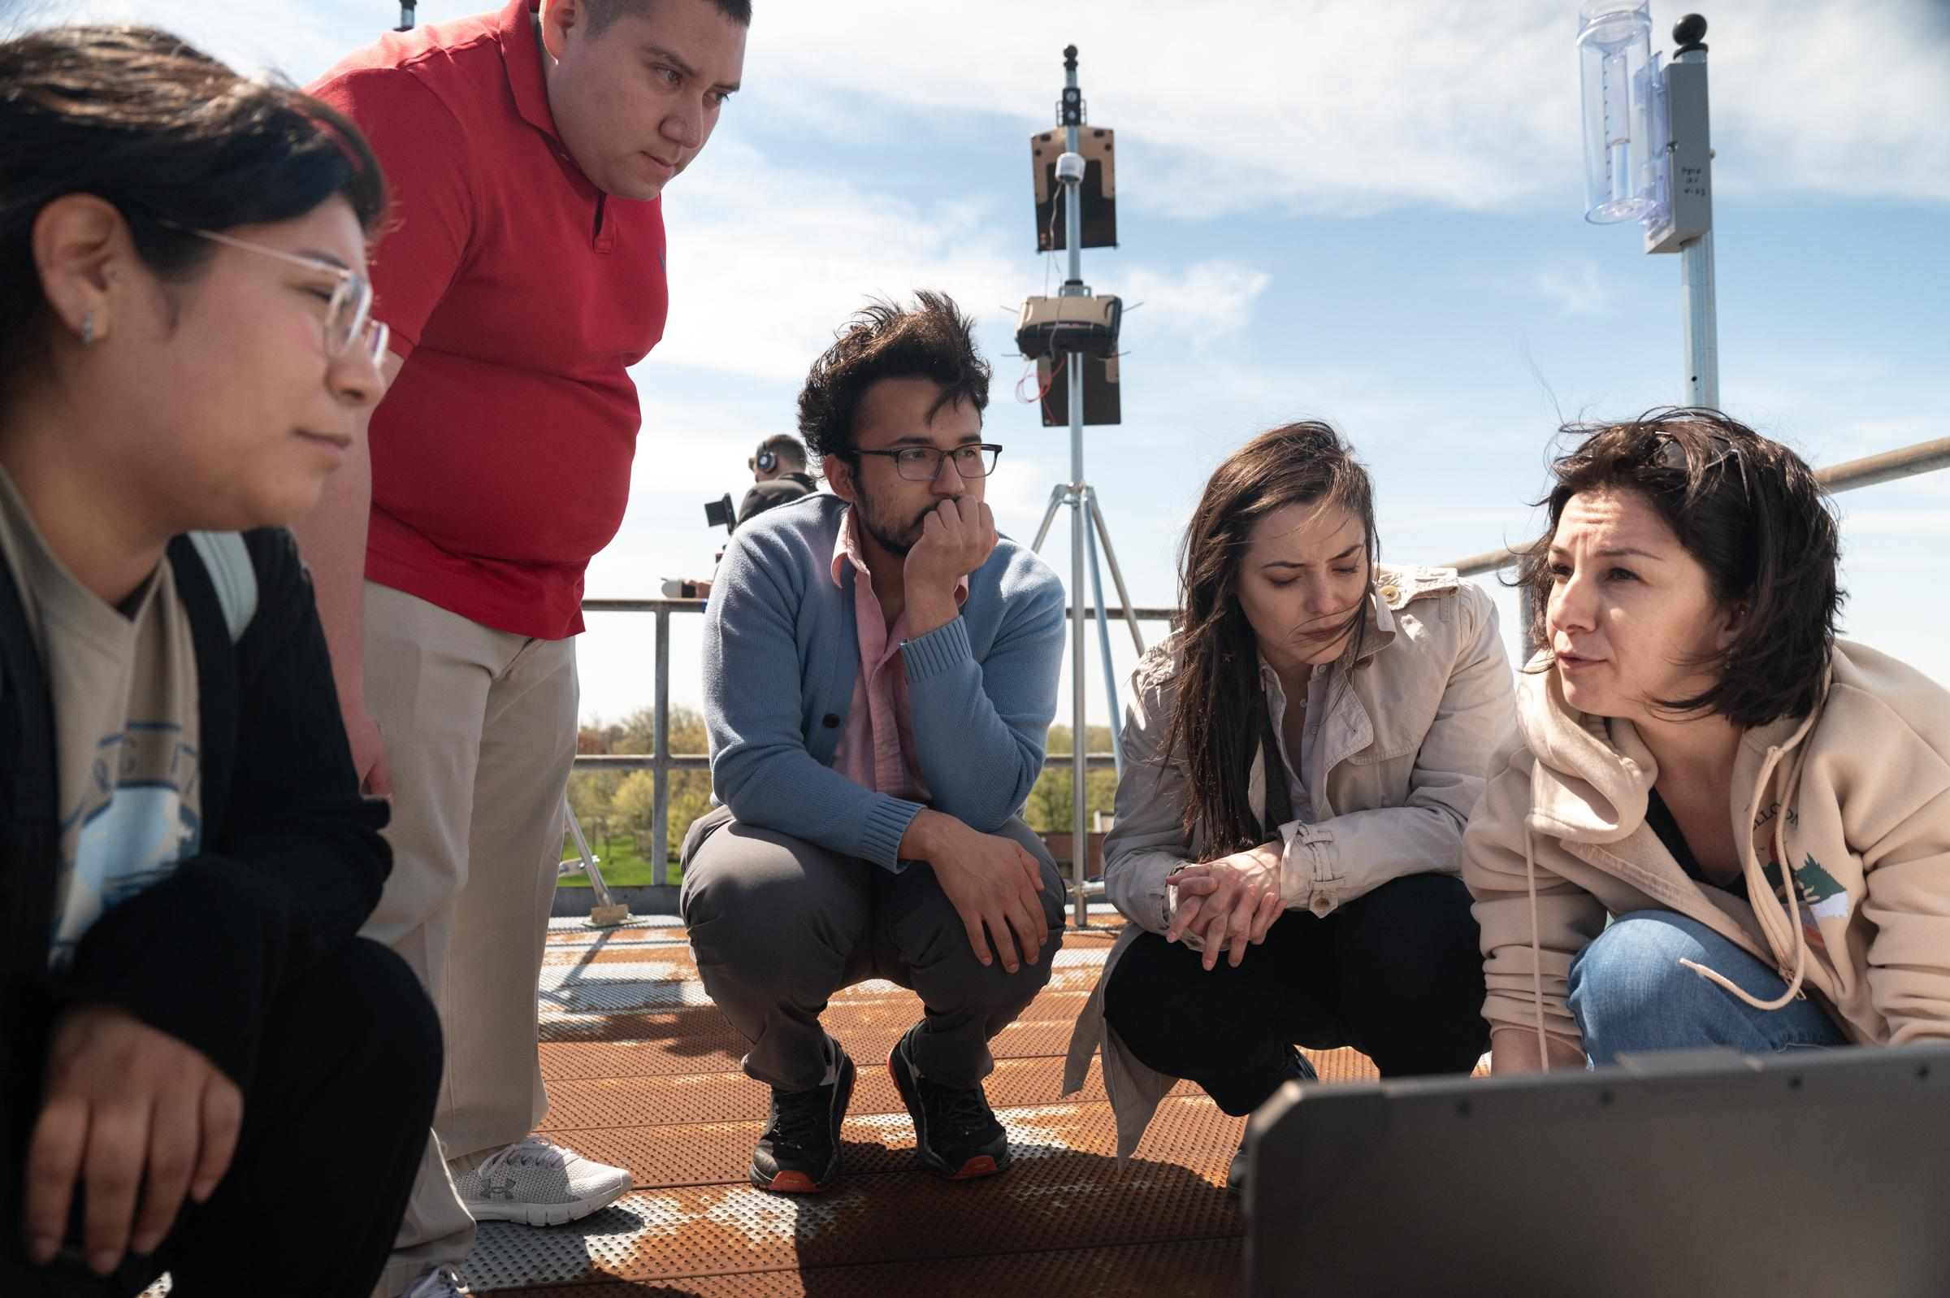
WHAT IS CROCUS
Community Research on Climate and Urban Science
CROCUS is fully participatory science.
CROCUS uses modeling, observations and community science to build a predictive understanding of urban climate including the study of resiliency measures.
Links four community partners: Blacks in Green, Puerto Rican Agenda of Chicago, Greater Chatham Initiative and the Metropolitan Mayors Caucus.

Slide 3
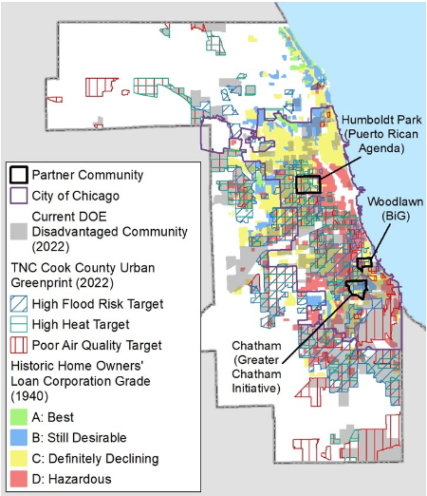
WORKING ACROSS DIVERSE COMMUNITIES
Our community partners and other stakeholders are integrated with our science groups.
We are not studying the communities of Chicago. We are working with them to get the information they need for data driven resiliency solutions.
This is not easy. It requires purposeful inclusivity. This includes, but is not limited to, care with the language we use. Beware the curse of knowledge!

Slide 4
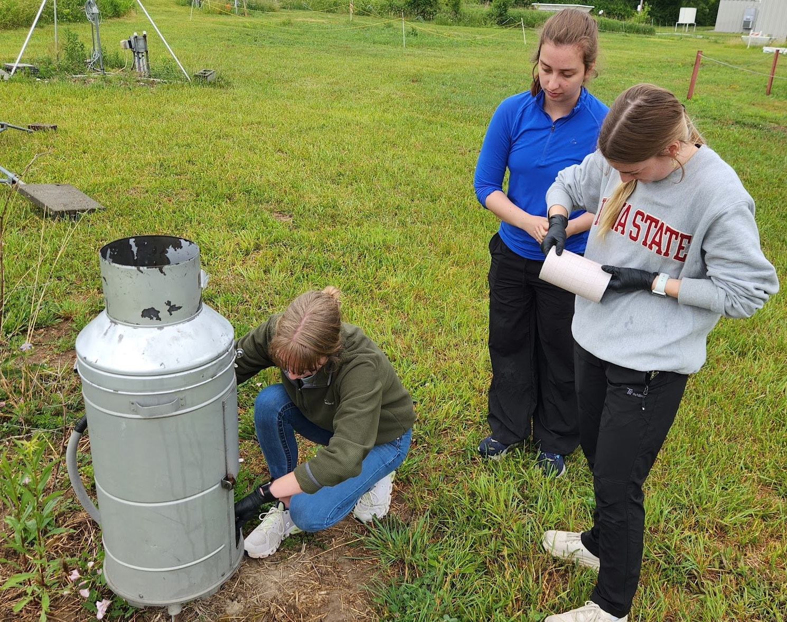
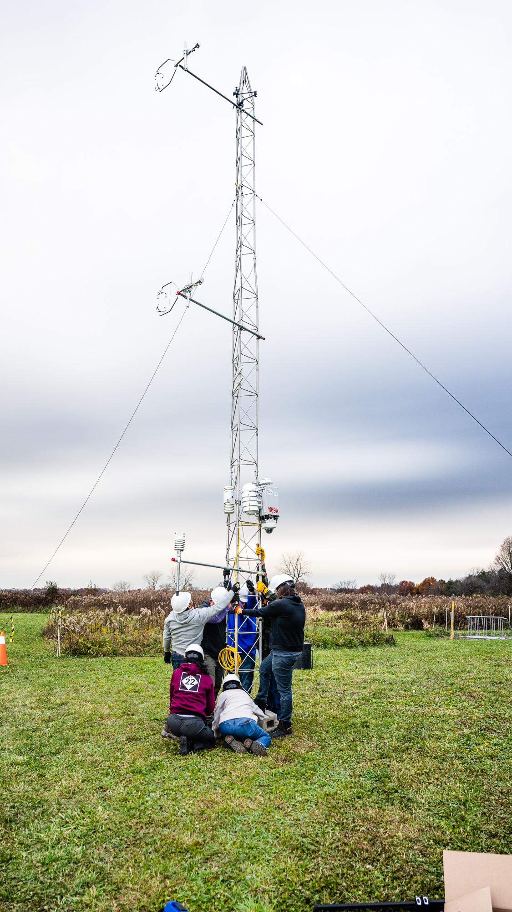
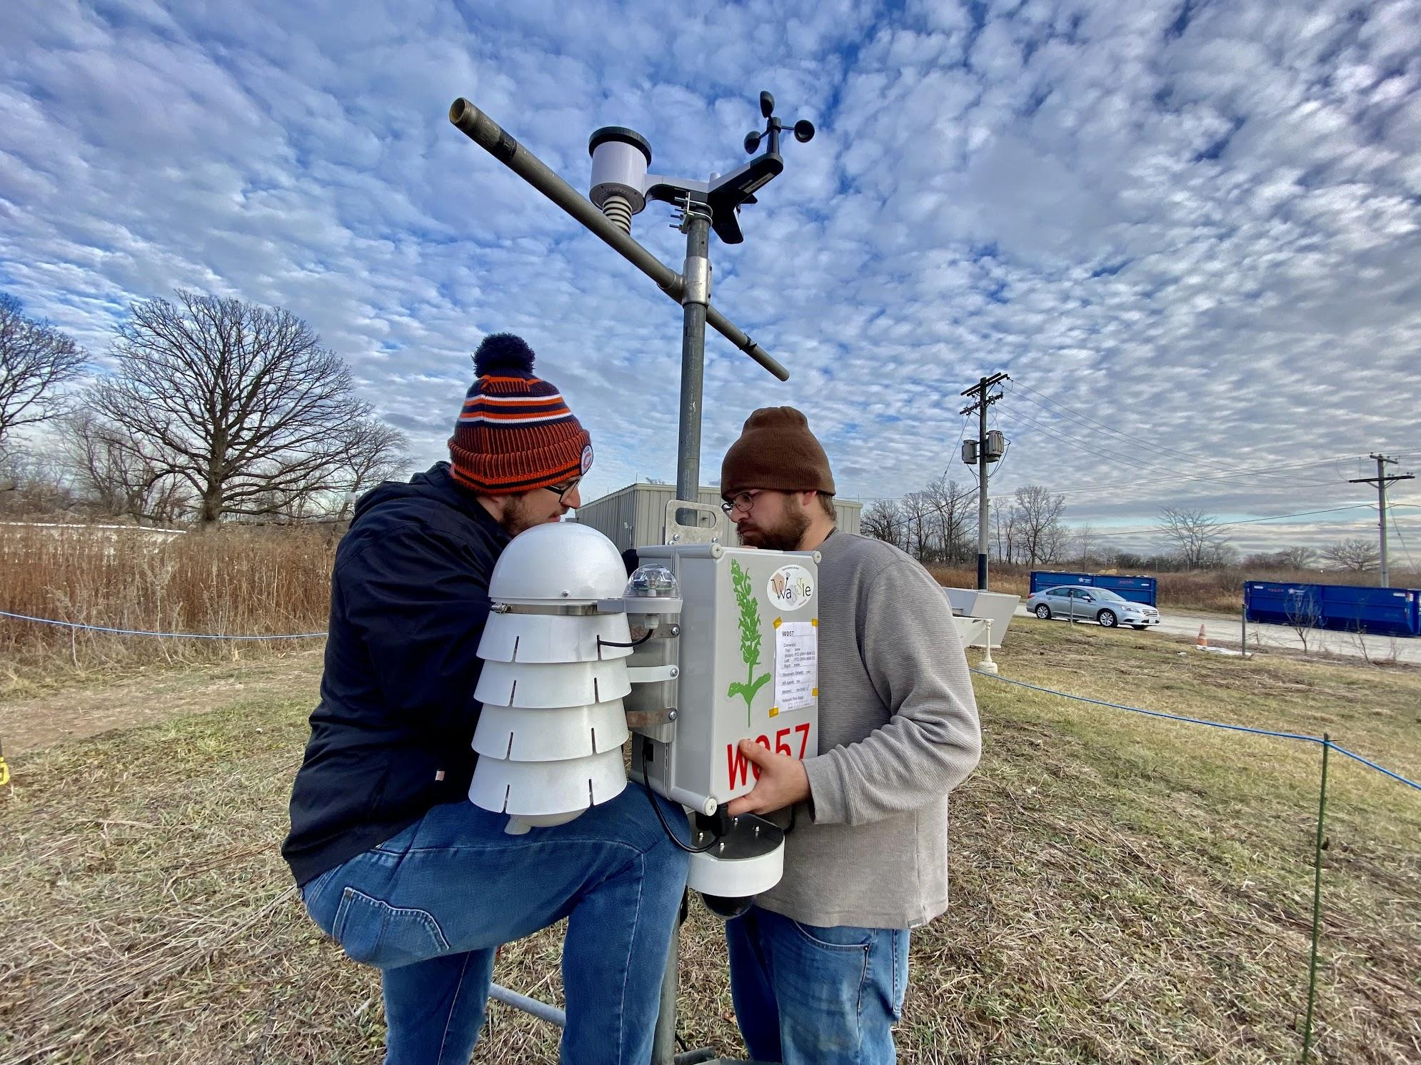
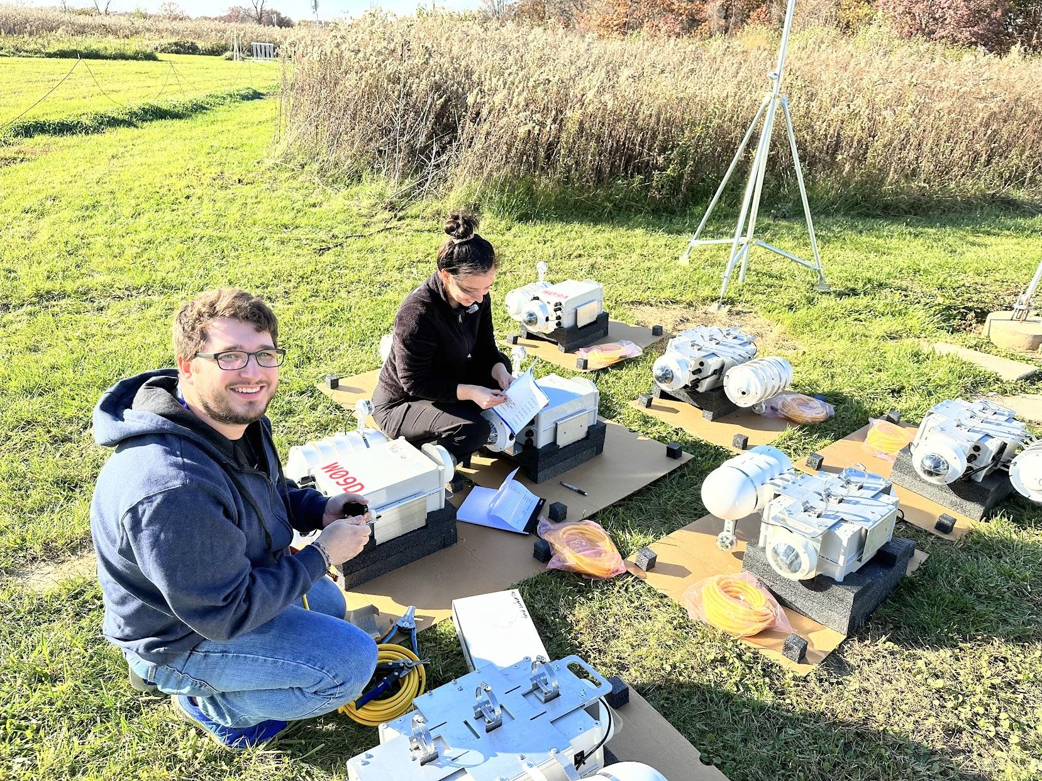
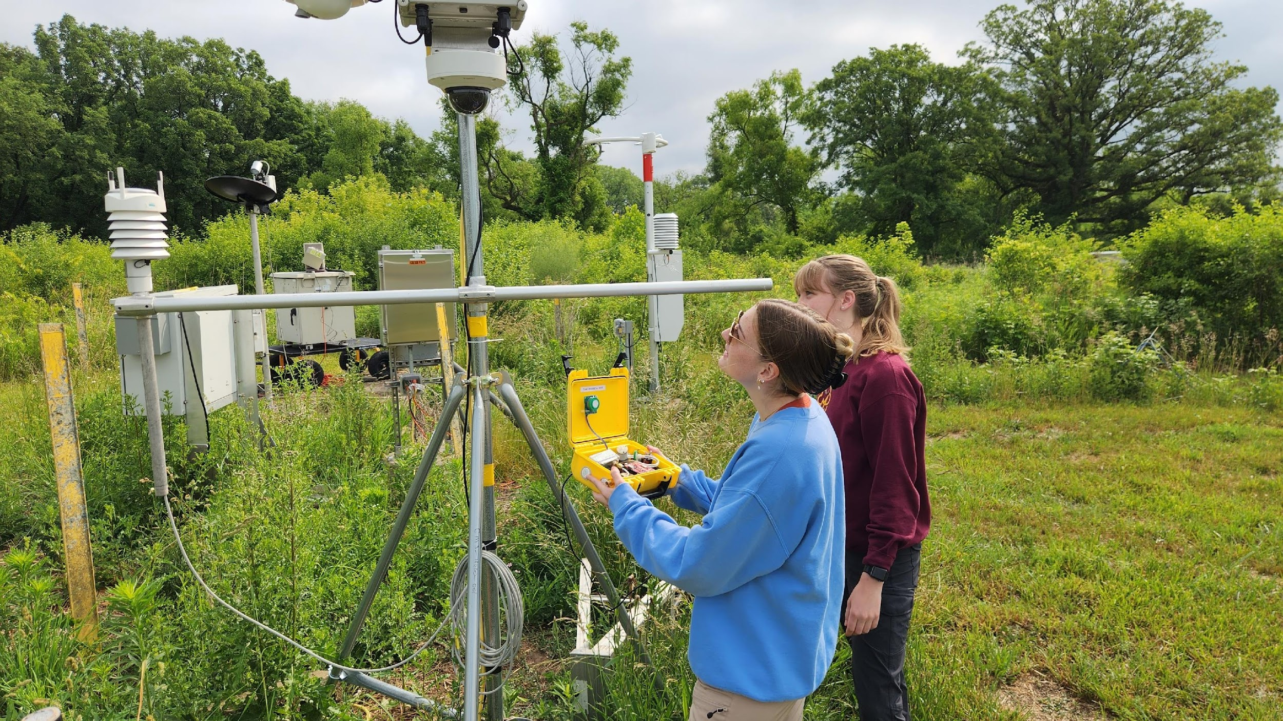
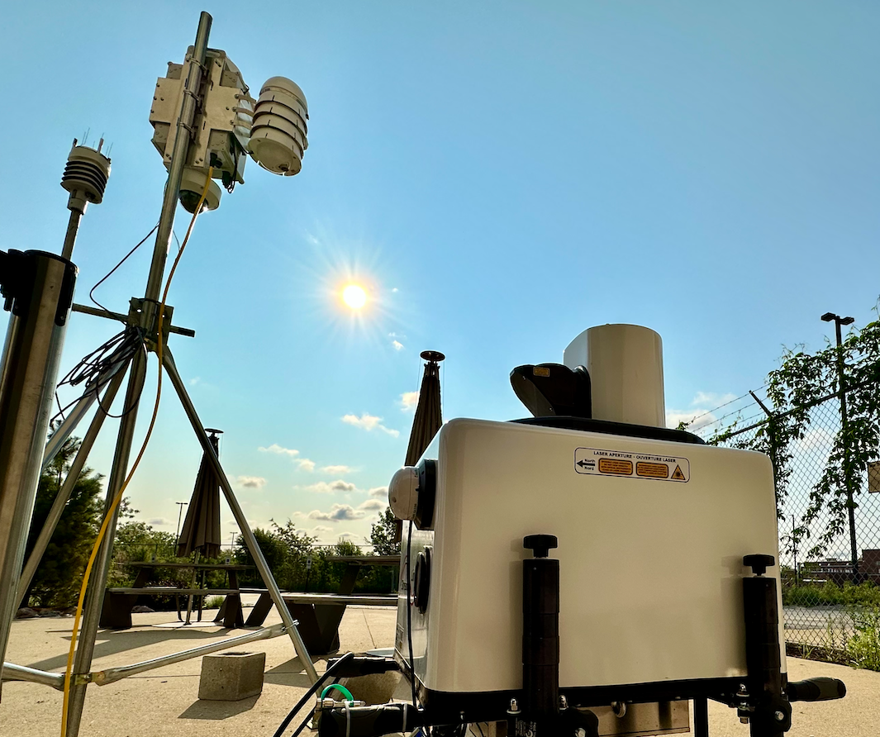
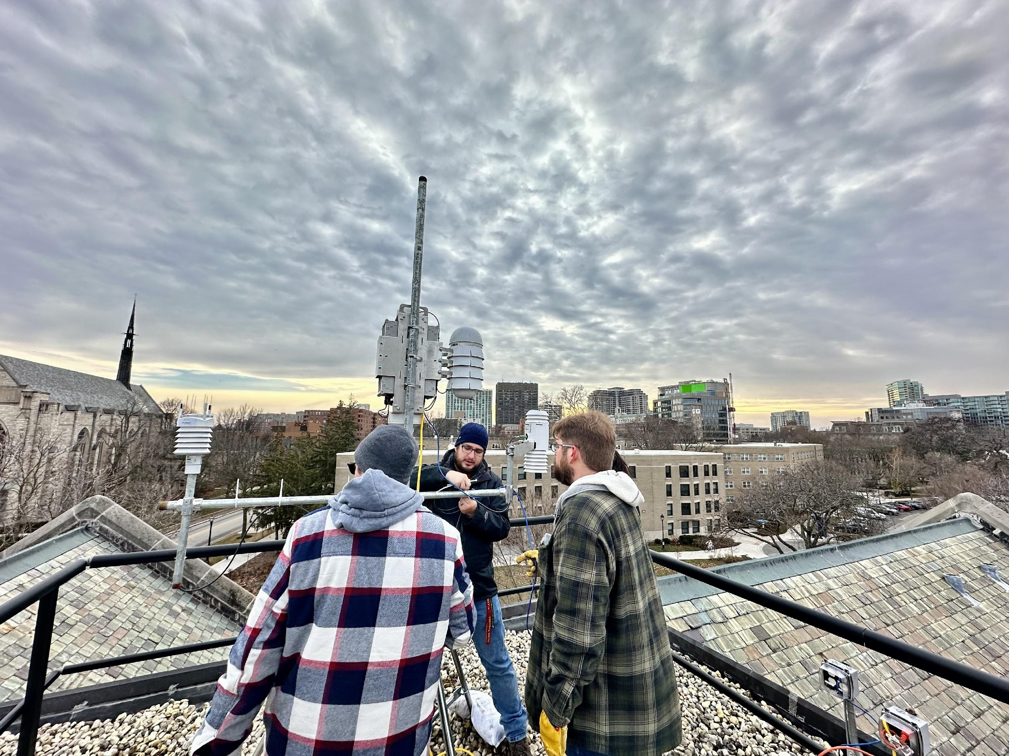
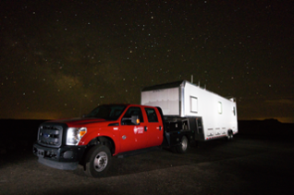
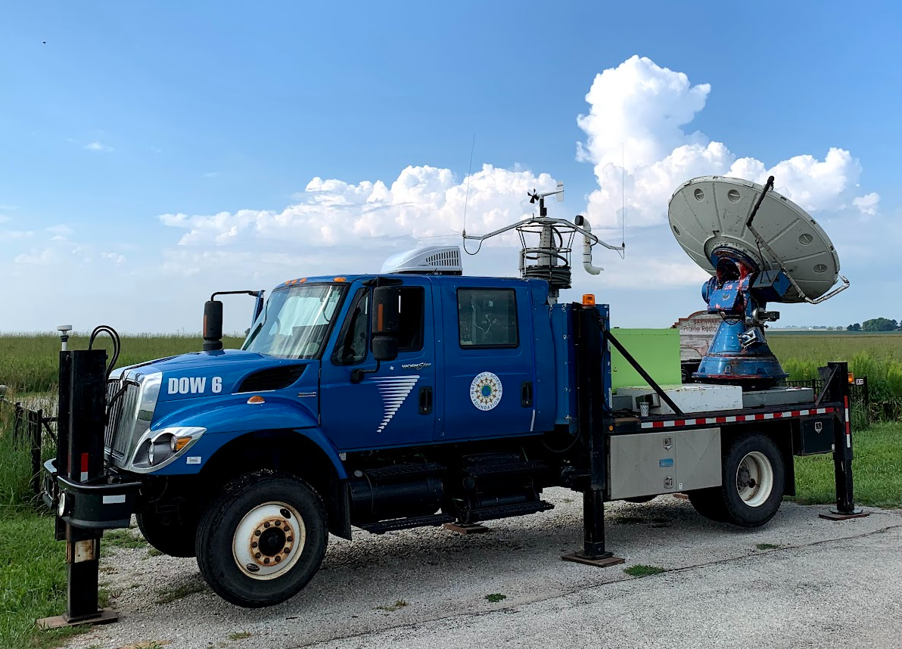
MEASUREMENT STRATEGY
Four components: Micronet, field campaigns, public data & community science.
Chicago Micronet
Network of 21 observatories
AI enabled by Waggle.
Field campaigns, bringing the most advanced instrumentation to Chicago.
Students involved throughout! Developing the diverse workforce of the future.
Notes:
Definition (Appendix 5)
Purchase Plan by Year (L1, L2, L3)
In-kind Contributions – how do we validate?
Effort needed for instrument operation and maintenance
Drivers
Challenges/Opportunities
Assignable Actions

Slide 5
WHAT OBSERVATIONS ARE PLANNED FOR CROCUS?

Slide 6
OVERVIEW OF CROCUS NODES
Instrumentation Categorized by Site
Level 1 Node
Wild Sage Node
All-in-one Weather Station (WXT)
Air Quality Sensors
Level 2 Node
Wild Sage Node
All-in-one Weather Station
Air Quality Sensors
Laser Disdrometer
Optical Particle Counter
Radiometer
Eddy Correlation Flux System
Steerable Thermal Camera
Level 3 Node
Wild Sage Node
All-in-one Weather Station
Air Quality Sensors
Laser Disdrometer
Optical Particle Counter
Radiometer
Eddy Correlation Flux System
Steerable Thermal Camera
Scanning micropulse Lidar system
Ceilometer
Vertically pointing microwave rain radar

Slide 7
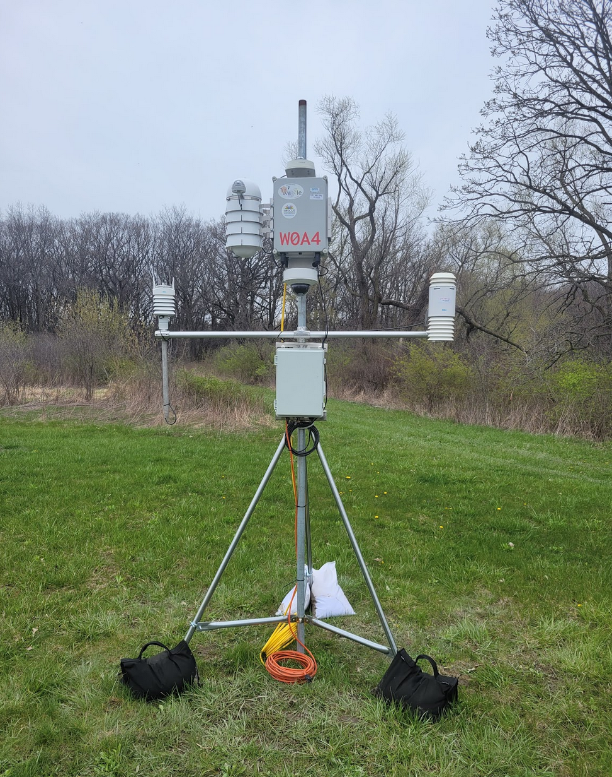
OVERVIEW OF CROCUS NODES
Observations Categorized by Site
Level 1 Node
Edge Compute, Camera Imagery, Audio
Temperature, RH, Atmosphere Pressure, 2D Wind Speed and Direction, and Precipitation
PM1, PM2.5, PM10
NO2, NO, CO, O3
Level 2 Node
All Level 1 Node Observations
Drop size distribution, precipitation rates, fall speeds, equivalent radar reflectivity factor
Aerosol particle size distribution
Upwelling and Downwelling solar radiation
Momentum, Sensible Heat, Latent Heat, CO surface fluxes, 3D winds
Surface and Cloud Temperatures
Level 3 Node
All Level 1 Node Observations
All Level 2 Node Observations
Doppler spectra of hydrometeors
3D winds

Slide 8
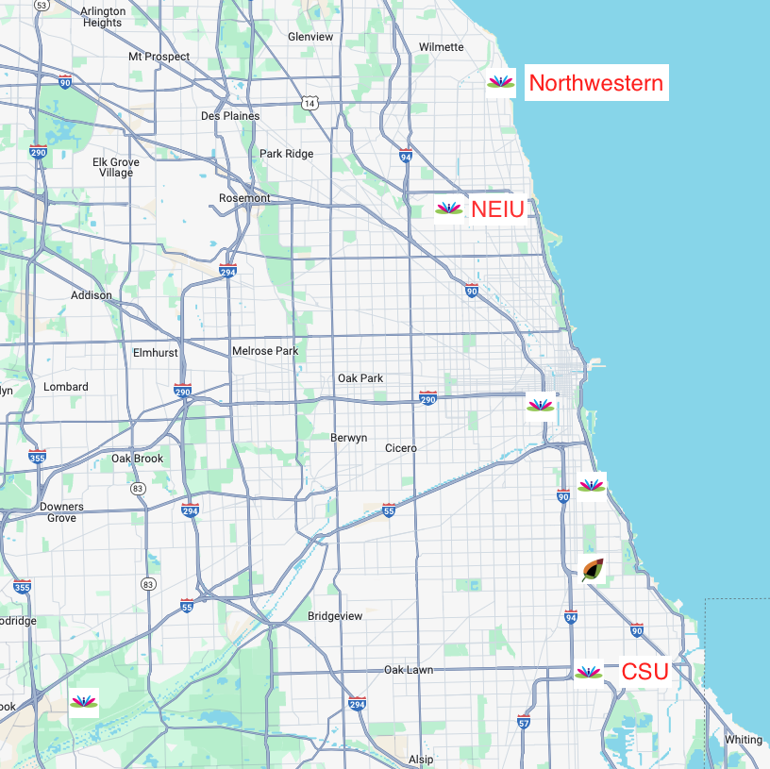
Chicago Micronet
Current Nodes
Three active CROCUS nodes within the city at CROCUS partner institutions.
Four deployments planned this summer to partner and champion locations.
Five Rapid Response nodes will be deployed as apart of IOP period this summer.

Slide 9
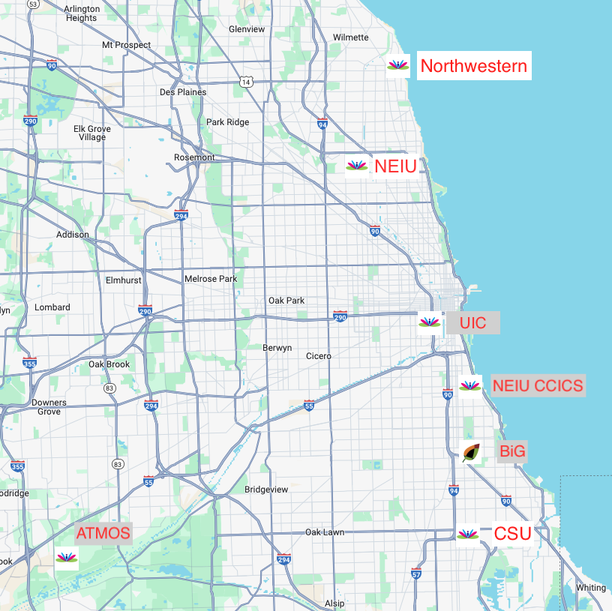
Chicago Micronet
Summer 2024 Planned Nodes
Three active CROCUS nodes within the city at CROCUS partner institutions.
Four deployments planned this summer to partner and champion locations.
Five Rapid Response nodes will be deployed as apart of IOP period this summer.

Slide 10
CROCUS METEOROLOGICAL SENSOR

Slide 11
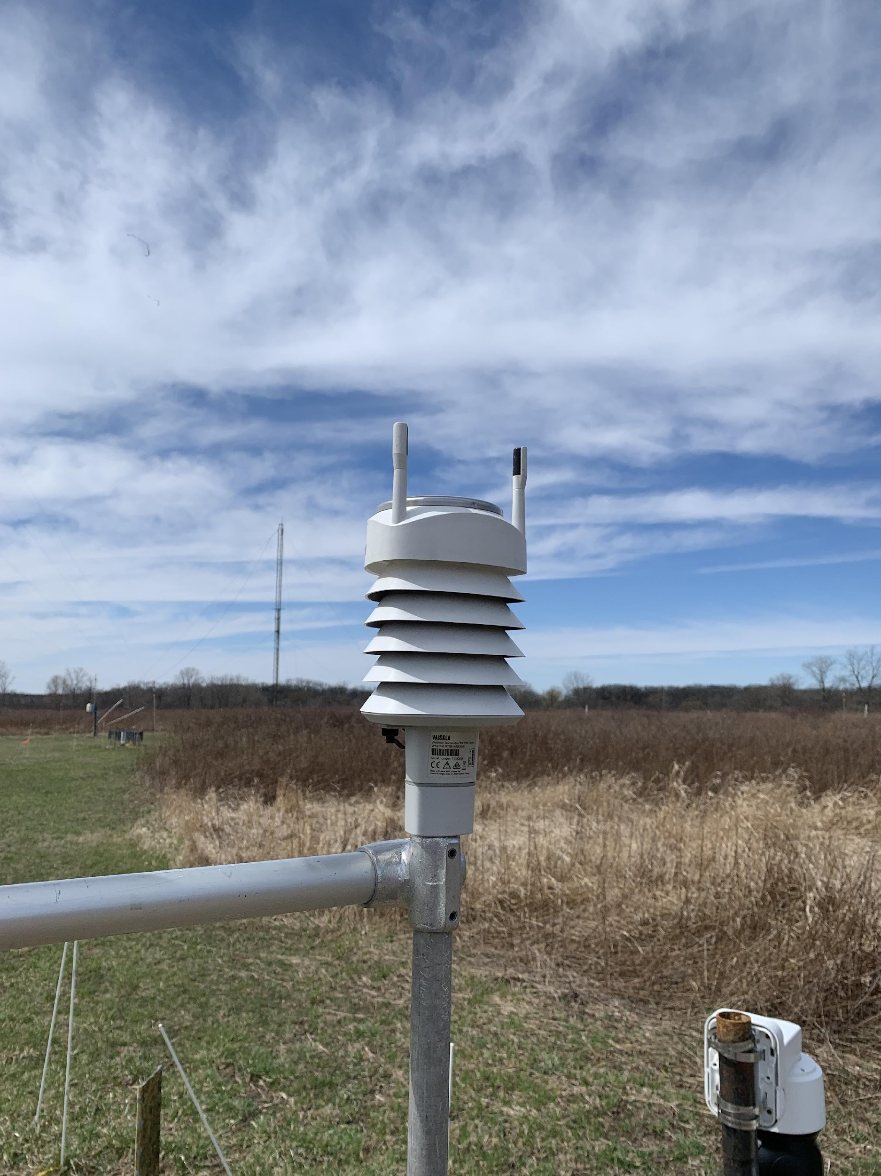
VAISALA WEATHER TRANSMITTER
Vaisala WXT536
Specifications:
1.54 lbs (0.7 kg)
4.52” x 4.48” x 9.37”
Operating power:
6 – 24 VDC (1.5mA at 12 VDC)
Heating power:
12 – 24 VDC (1.1A at 12VDC)
Interface:
ASCII polled via serial communication
RS-232, RS-485, RS-422 options

Slide 12
VAISALA WEATHER TRANSMITTER
Vaisala WXT536
Measurement | Range | Accuracy
Pressure | 600 – 1100 hPa | ±1 hPa
Temperature | -60 to +140℉ | ±0.54 ℉
Relative Humidity | 0 to 100 %RH | ±3% - 5% RH
Wind Speed and Direction | 0 – 60 m/s 0 – 360° | 3% at 10 m/s
Rainfall | 0 – 200 mm/h | ”better than 5%”

Slide 13
CROCUS AIR QUALITY SENSOR

Slide 14
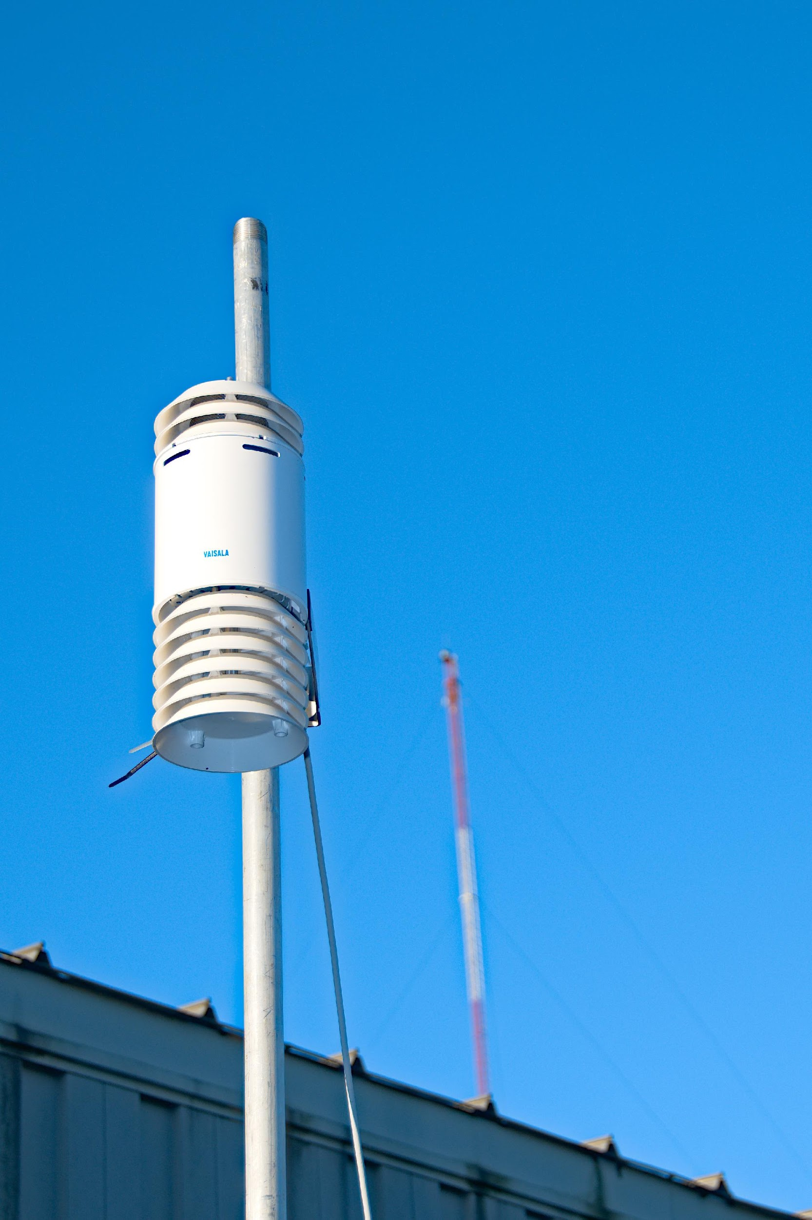
VAISALA AIR QUALITY TRANSMITTER
VAISALA AQT530
Specifications:
5.29 lbs (2.4 kg)
13.19” x 5.24”
Operating power:
10 – 25 VDC (1.0A at 10 VDC)
Interface:
ASCII via serial communication
RS-485
Important to note:
Gas and Particle Sensors are separate
Different reporting intervals

Slide 15
VAISALA AIR QUALITY TRANSMITTER
VAISALA AQT530
Measurement | Range | Accuracy
NO2 | 0 - 2000 ppb | 5 ppb
NO | 0 - 2000 ppb | 15 ppb
O3 | 0 - 2000 ppb | 6 ppb
CO | 0 - 10,000 ppb | 183 ppb
PM2.5 | 0 – 1000 µg/m3 | 9 µg/m3
PM10 | 0 – 2500 µg/m3 | 13 µg/m3
Temperature | -22 to +104℉ | 0.17℉ at +68℉
Pressure | 800 – 1150 hPa | 15 hPa
Humidity | 0 to 100 %RH | ±3% - 5% RH
Notes:
2000

Slide 16
HOW DO I ACCESS CROCUS OBSERVATIONAL DATA?

Slide 17
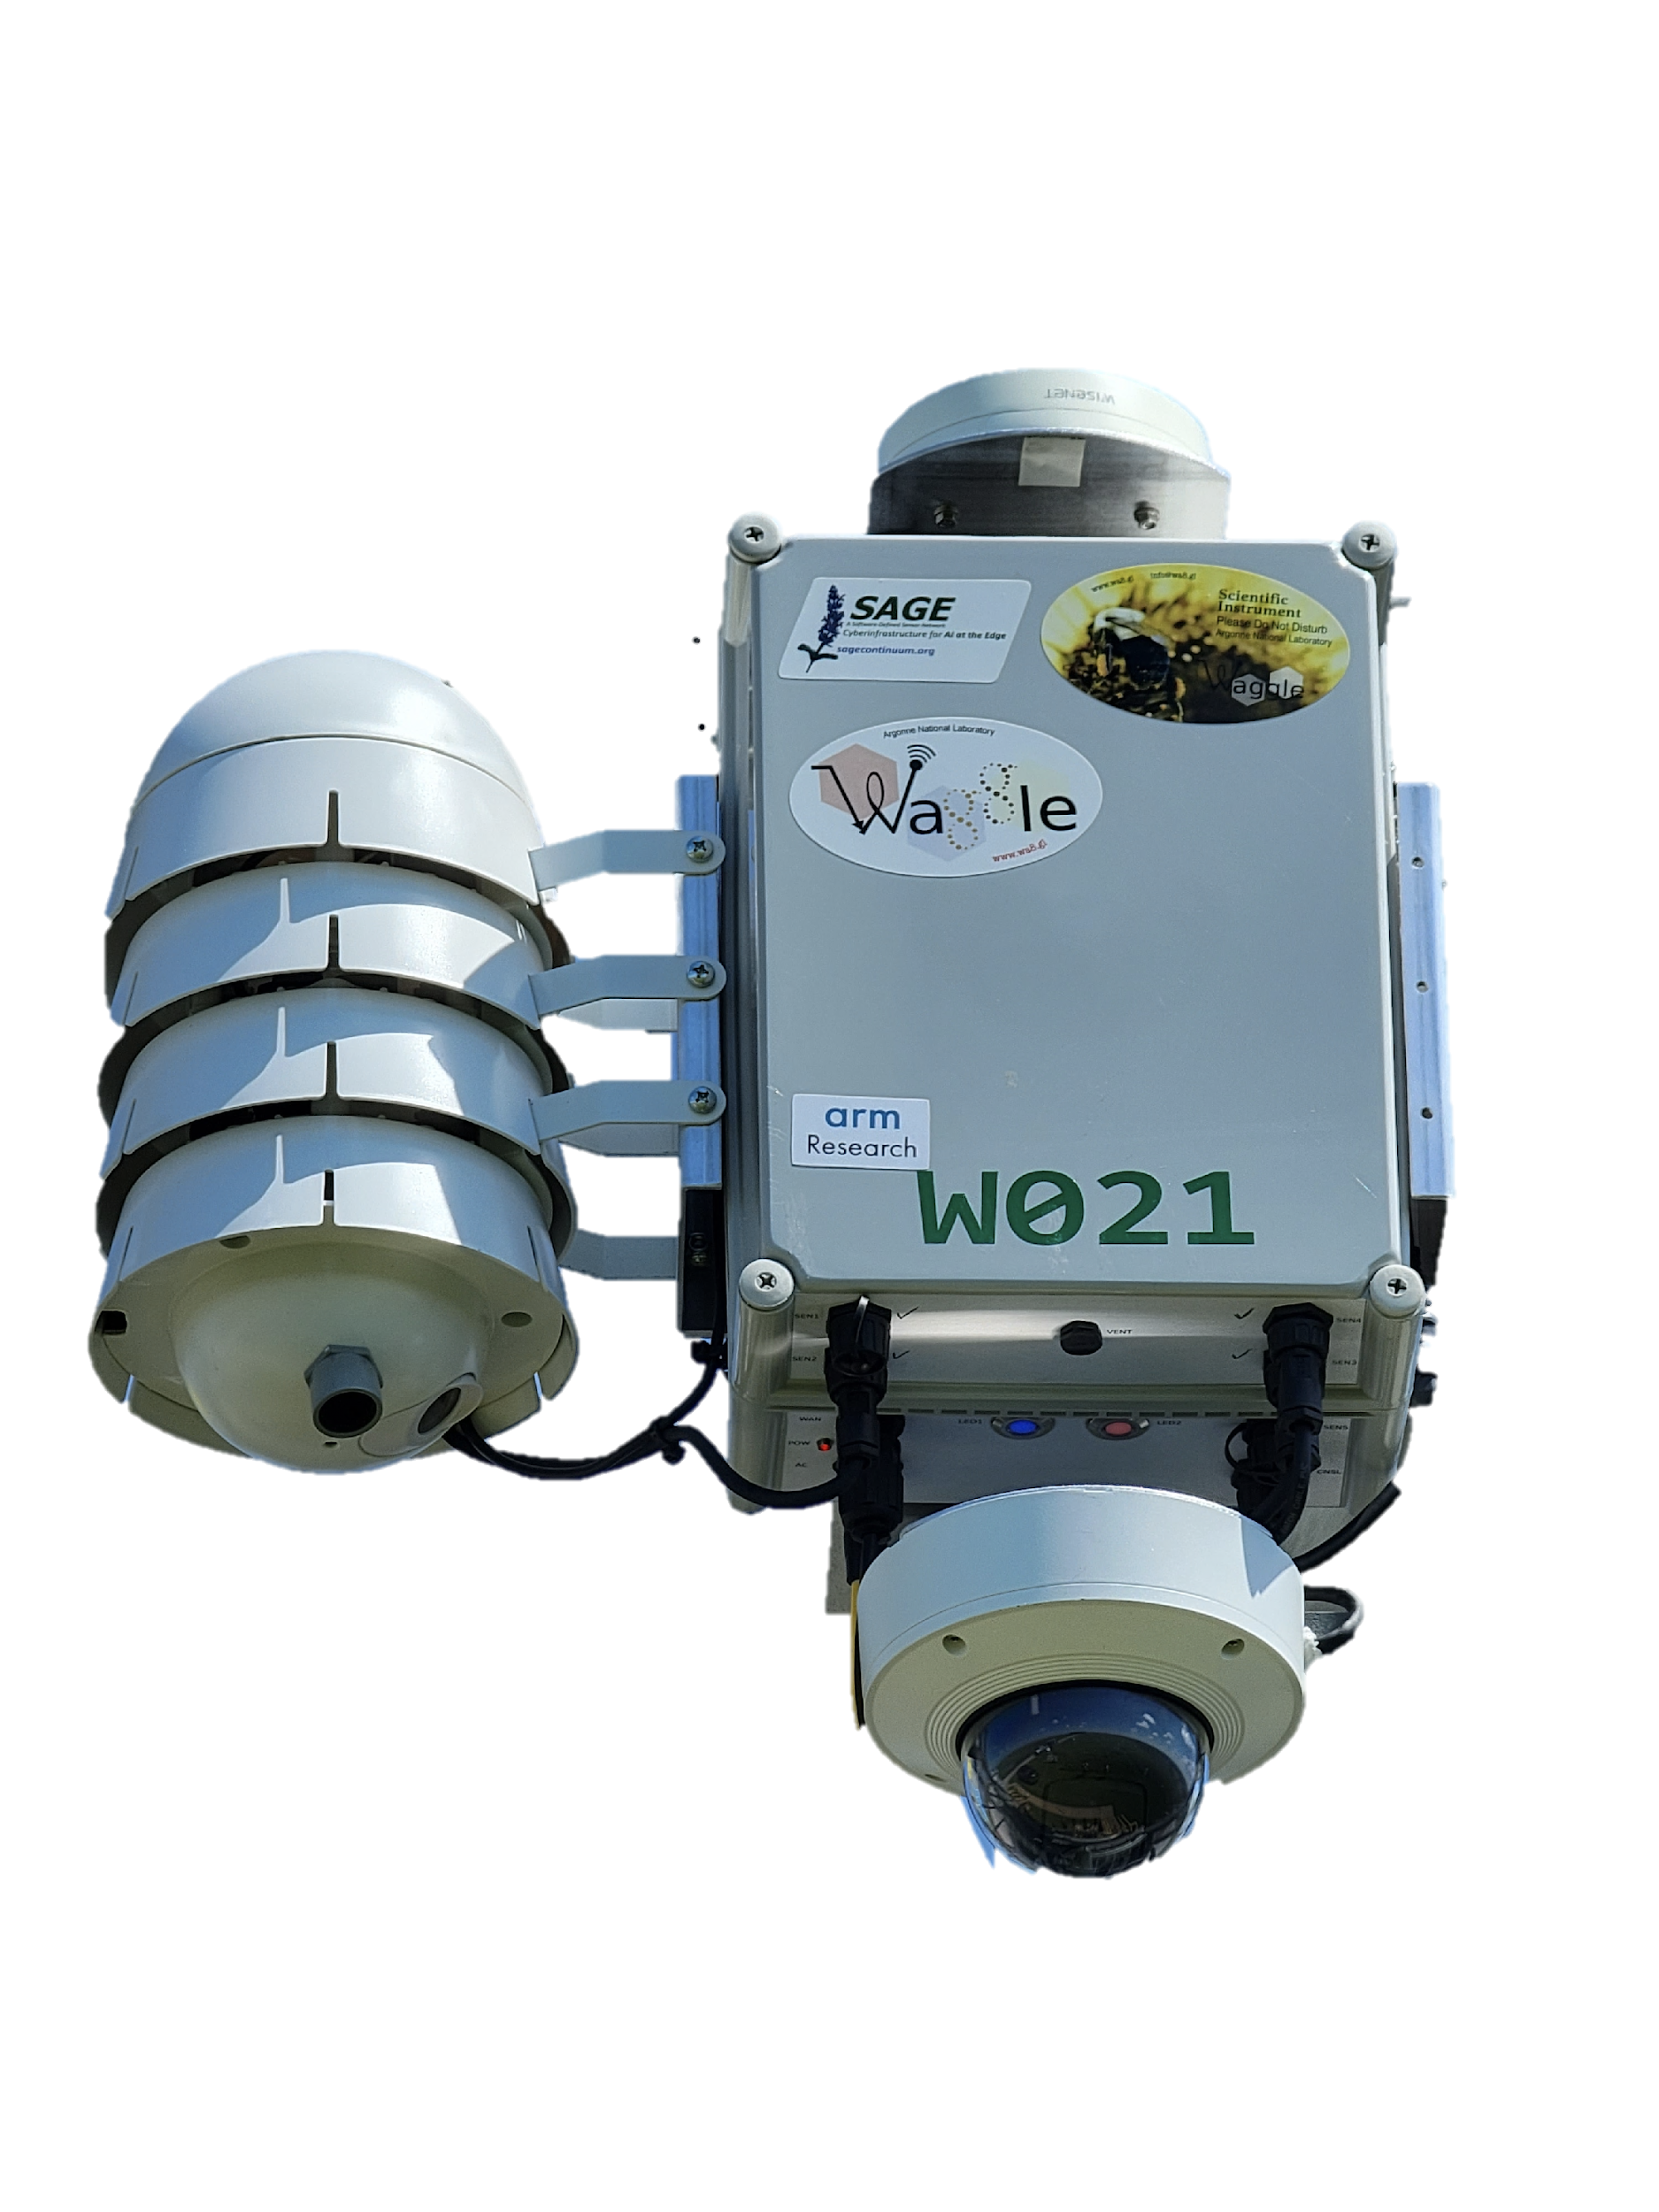
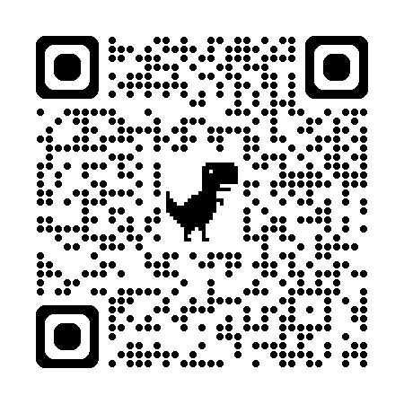


AN OVERVIEW OF CROCUS OBSERVATIONAL DATA: CONNECTING VIA WAGGLE
Edge computing, where control and inference can be carried out at the sensor, is vital for adaptability and other concerns like privacy.
Waggle is AI@EDGE cyberinfrastructure
Data
Users

Slide 18
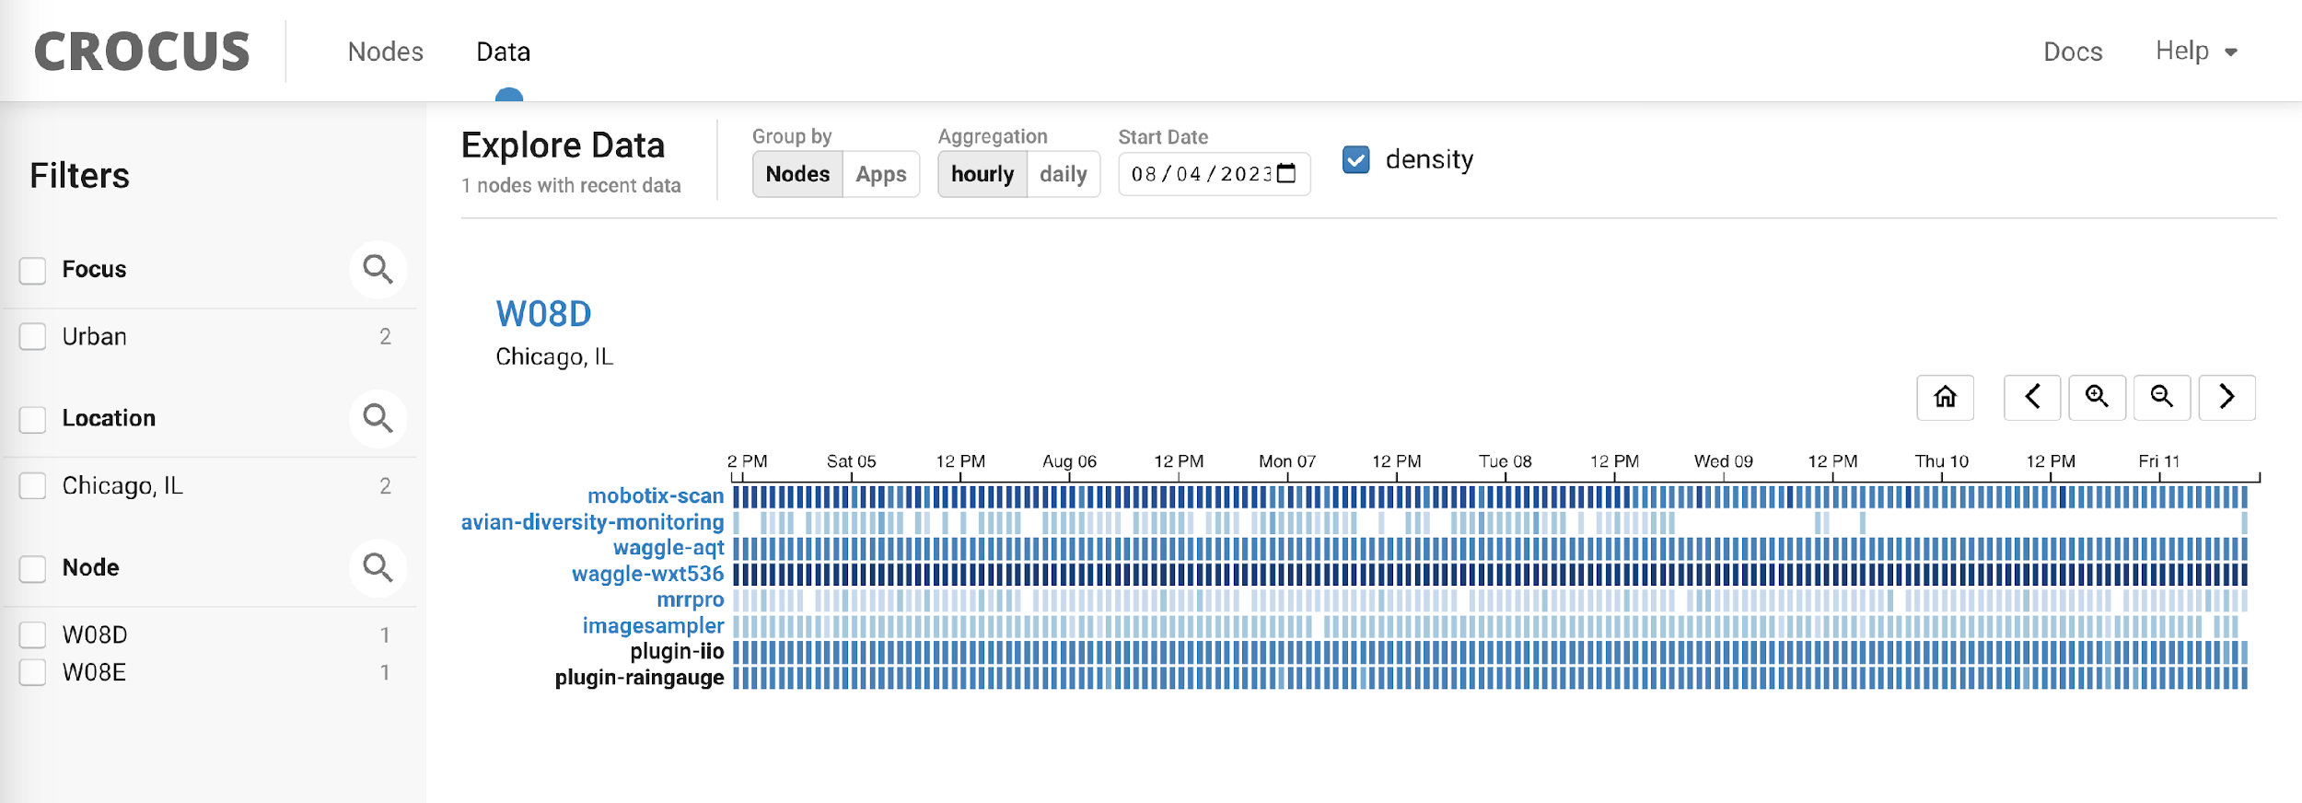
HOW DO WE ACCESS THE DATA?
An Overview of the Data Access Protocol

Slide 19
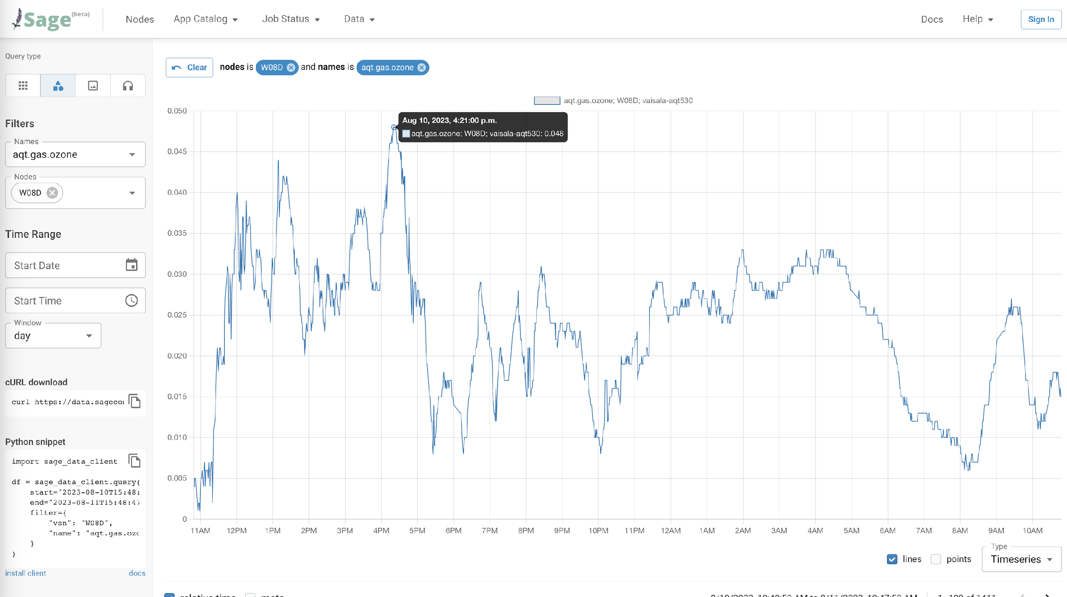
DOWNLOADING THE LIVE DATA
Using the User Interface

Slide 20
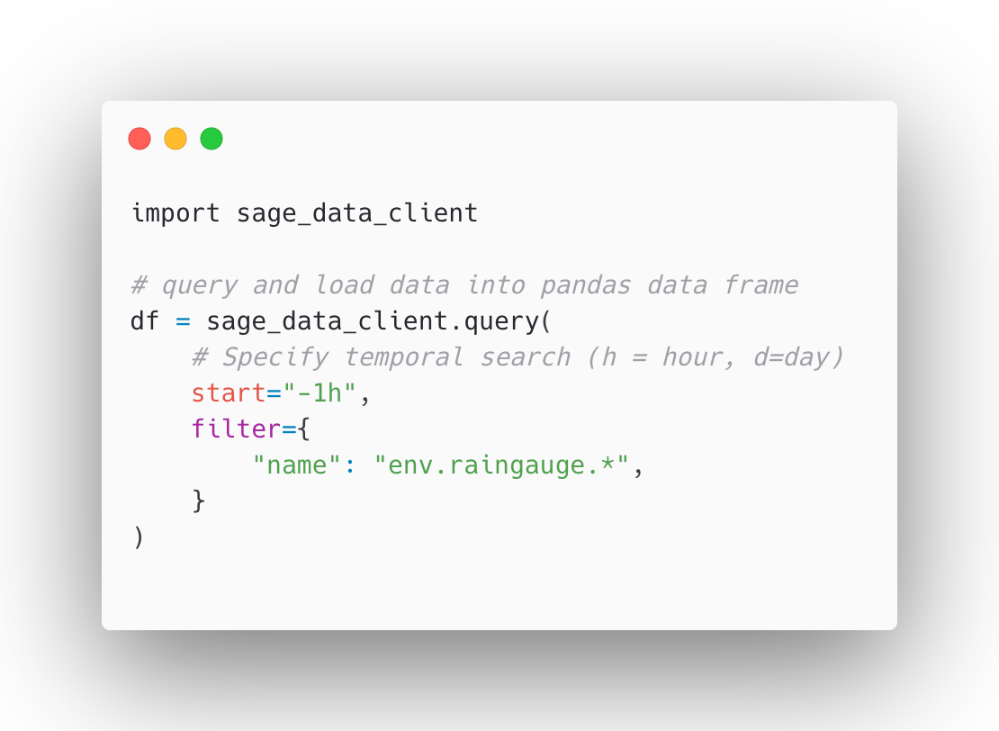
THE SAGE DATA CLIENT
Accessing the Data Programmatically
Goals of the sage-data-client package
Provide simple query that talks to data API
Provide results in a Pandas dataframe (think CSV)

Slide 21
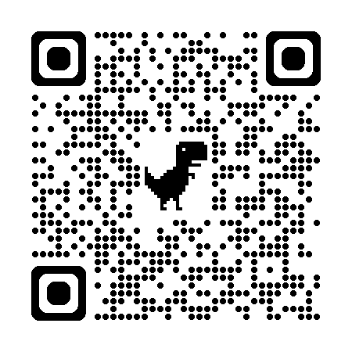




DATA CONVERSION: MOVING FROM THE EDGE TO LONG-TERM STORAGE
Enabling Analysis-Ready Datasets
netCDF data is a binary data format , commonly used in the geoscience community
Includes rich metadata support + compression
CROCUS THREDDS Server
Waggle
Beehive
Raw
Data Converted to netCDF + aggregated
Quicklooks,
Scientific Analysis
Sage/Waggle Portal

Slide 22



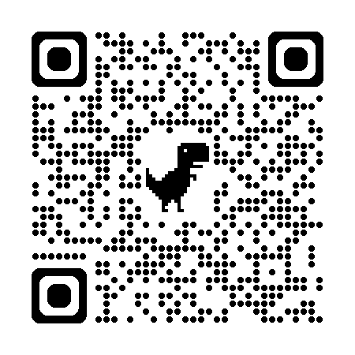
DATA CONVERSION: Quality Controlled Datasets
Connection to the broader scientific community
DOE ESS-Dive will be the central repository for all U-IFLs
Quality Controlled data can be expected within 6 months of acquisition
CROCUS THREDDS Server
DOE ESS-Dive
Waggle
Beehive
Raw
Data Converted to netCDF + aggregated
Quicklooks,
Scientific Analysis
Quality Control, citable datasets
Sage/Waggle Portal

Slide 23
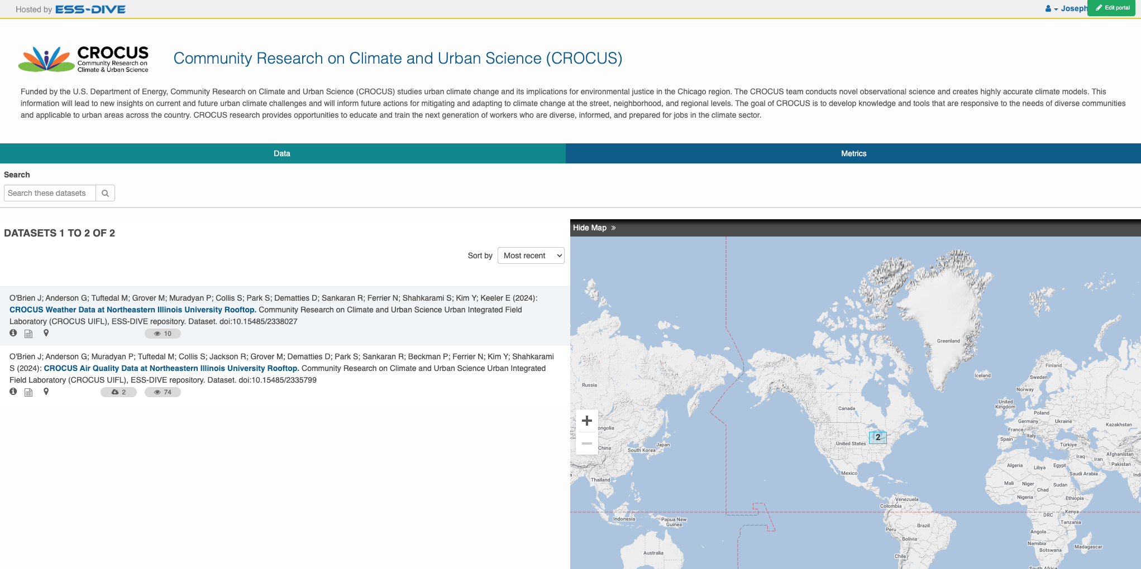
CROCUS ESS-Dive Portal
https://data.ess-dive.lbl.gov/portals/crocus

